Slide 1

International Enterprise Architecture Standards, Organizations & Activities
17 January 2007
L. Mark Walker

Slide 2
Agenda
Background
The Multitude of Architecture Standards Activities
  1- ISO:
  TC184/SC5/WG1 (Four Enterprise Architecture Standards)
  JTC1/SC7/WG42 (based on IEEE 1471, ISO 15288, 12207, etc.)
  2- Governments:
  US: DODAF, FEAF, CADM, etc.
  Europe: MODAF, etc.
  3- Others: OMG (SysML, UML, ArchSC), TOGAF, etc.
Status and Challenges for INCOSE, ISO, etc.
  INCOSE Chesapeake Chapter Involvement?

Slide 3
Overall Multitude Int’l Architect Standards, etc
ISO
The Others
15704
25961
(IEEE 1471, etc.)
Europe:
MODAF,
ETC
US/DoD:
FEAF,
DODAF,
CADM,
ETC
14258
(2D)
15288
(SE)
12207
(SW)
19439
(3D)
19440
Model
Language
OMG:
SysML,
UML,
ETC
IEEE,
TOGAF,
ETC
ETC
ISO Liaisons ?
ISO Liaisons
10303:
AP233, etc.
Vocabulary
&
Definitions
Others: Japan,
China, etc. ?
INCOSE Liaisons ?
ISO TC184/SC5
ETC
ISO JTC1/SC7
Bottom Line: People are in Multiple Int’l Efforts

Slide 4
ISO’s Key Architecture Working Groups
ISO/TC184/SC5/WG1 is the lead for development of Four ISO Enterprise Architecture Standards based on manufacturing industry needs
  TC184/SC5/WG1 initiated the upgrade planning for their ISO 15704 this summer
ISO/JTC1/SC7/WG42 is developing an architecture standard by “fast tracking” IEEE 1471
  JTC1/SC7/WG42 formed in June 06
ISO/JWG8 is developing the Data Standards including 10303, 100s of standards including AP233
ISO SC5/SG1 & SC7: identifying vocabulary overlaps/conflicts and recommending commonality/”Harmonization”

Slide 5
1- ISO Enterprise Architecture Standards- TC184
Chair: Emanuel dela Hostria (USA)
Contact: ISO/TC 184/SC 5 Secretariat: gre_winchester@nema.org
ISO/TC 184
Industrial Automation Systems & Integration
SC 1
Physical
Device
Control
SC 2
Robots for
Manufacturing
Environments
SC 4
Industrial
Data
SC 5
Architecture,
Communications &
Integration Frameworks
Advisory
Group
WG4
NC Programming
Languages
PPC
Policy & planning committee
WG1-Richard Martin Lead
Modeling & Architecture
PT1
Revision of
ISO 10218
MT1
Communications & Interconnections
QC - Quality Committee
WG7
Data modeling for
integration of physical
devices
WG2
Part Library
WG4
Manufacturing Software & Environment
WG3
Product Modeling
WG5
Application Integration Frameworks
WG8
Distributed installation in industrial applications
JWG8**
Industrial manufacturing
management data
WG6
Application Service Interface
JWG9
Electrical & electronic
applications
WG7
Diagnostics/Maintenance/Control Integration
JWG8**
Industrial manufacturing management data
Key Current Architecture WGs of Interest
WG11
Express language, implementation methods
JWG15
Enterprise-Control System Integration
Note: Other WGs may also be of interest.
WG12
Common resources
SG1
Vocabulary and terminology

Slide 6
The 4 ISO/TC184/SC5/WG1 EA Standards
Stanrd | Title | Key Focus | Status
15704-2000 | Industrial automation systems — Requirements for enterprise-reference architectures and methodologies | Enterprise-reference architectures; provides means of organizing engineering projects. Includes requirements. Based on GERAM | WG1 initiated systematic review summer 06, leading to a revision project that commenced late 2006.
19439 | Enterprise integration — Framework for enterprise modelling | Ent Arch Models & Modeling Phases (planning), views & genericity. | Published May06.
19440 FDIS | Enterprise integration — Constructs for enterprise modelling | Computer modeling language and key elements. | Completed and in for balloting. May be final by early ‘07.
14258-1998 | Industrial automation systems — Concepts and rules for enterprise models | Provides enterprise level architecture modeling basis. Business, operational and metamodel. | 15704 will replace 14258 when 15704 new version is approved

Slide 7
ISO 15704-2000
Industrial automation systems — Requirements for enterprise-reference architectures and methodologies

Slide 8
15704 - Scope
Covers topics deemed necessary to carry out all types of enterprise projects required for the life of the enterprise, including:
  Enterprise creation,
  Major enterprise restructuring efforts
  Incremental changes,
  Parts of the enterprise-life cycle.

Slide 9
ISO 15704 Basis: GERAM
(Generalized Ent. Reference Arch Methodology)
Generalized Enterprise Reference Architecture identifies concepts of enterprise integration
Enterprise Engineering Methodology describe process of enterprise engineering
Enterprise Modeling Languages provide modeling constructs for modeling of human role, processes and technologies
employs
utilize
Generic Enterprise Modeling Concepts (Theories and Definitions) define the meaning of enterprise modeling constructs
Implemented in
Enterprise Engineering Tools support enterprise engineering
support
Partial Enterprise Models provide reusable reference models and designs of human roles, processes and technologies
used to build
Enterprise Models enterprise designs, and models to support analysis and operation
Enterprise MOdels provide implementable modules of human professions, operational processes, technologies
Enterprise Operational Systems support the operation of the particular enterprise
used to implement
(Adapted from ISO 15704)
Richard Martin

Slide 10
15704 - Key integration principles
Applicability to any enterprise
  total customer service solution involves information, culture & mission
Enterprise identification and mission definition
  must produce products or services desired by customers
Separation of mission-fulfillment functions from mission-control functions
  fulfilling the mission, i.e. operating processes that produce product or service
  achieve the desired economic or other gains that assure viability or continued successful existence of enterprise.
Two distinct transformation classes
  1-Information, 2-material & energy

Slide 11
15704 - Key enterprise integration principles (cont)
Identification of process contents, three classes of implemented tasks or business processes:
  information and control activities
  mission activities
  human activities,
Recognition of enterprise life-cycle phases
Evolutionary approach to enterprise integration
  projects can be carried out individually or collectively
Modularity
  activities & interfaces defined in modular fashion

Slide 12
ISO/FDIS 19439
Enterprise integration — Framework for enterprise modelling

Slide 13
ISO/FDIS 19439- 3 Dimensions
Systems Integration: Framework for Enterprise Modelling
genericity
Particular level
generic level
partial level
particular level
domain identification
Reference Catalog
organization view
concept definition
resource view
information view
requirements definition
enterprise model phase
function view
design specification
implementation description
enterprise modelling view
domain operation
not defined at the domain operation phase
Richard Martin
decommission definition

Slide 14
GERA Framework (Basis for 19439)
Generic
}
Subdivision
Views
Partial
according
Particular
to genericity
{
{
{
Instantiation
Identification
Subdivision
Customer service
}
according to
Concept
Management
purpose of activity
and control
Requirements
Software
}
Subdivision
Hardware
according to physical
Preliminary design
manifestation
Design
Resource
Detailed design
}
Subdivision
Organisation
Implementation
Information
according to
Function
model content
Operation
Decommission
Machine
}
Subdivision according
Human
to means of
implementation
Life-cycle phases
Richard Martin
Reference Architecture
Particular Architecture
Source: ISO 15704:2000 Annex A and Figure 10, The GERA modelling Framework of GERAM [GERAM V1.6.3 http://www.cit.gu.edu.au/~bernus ](used with permission)
Focus of ISO 19439

Slide 15
Recursion with 19439
Do
Enterprise A (operational)
C
Enterprise operations can model new enterprises either from its own particular models or using reference constructs and partial models.
R
Do
D
C
Do_{A} ⊇ Do_{B}
I
R
O
(new) Enterprise B
D
Dc
I
O
Dc
Do
Do
Do
C
C
C
Do_{R} ∪ Do_{A} ⊇ Do_{C}
R
R
R
D
D
D
I
I
I
reference catalog R
O
Dc
Dc
Dc
(new) Enterprise C
Richard Martin

Slide 16
ISO 19440 (2006/07)
Focus on: Modeling Language for “Modelers” (those who develop architecture & modeling tools, e.g. tool vendors)
Use of UML being attempted
  Evaluating SysML as alternative due to UML Limitations
Significant detail on modeling language constructs

Slide 17
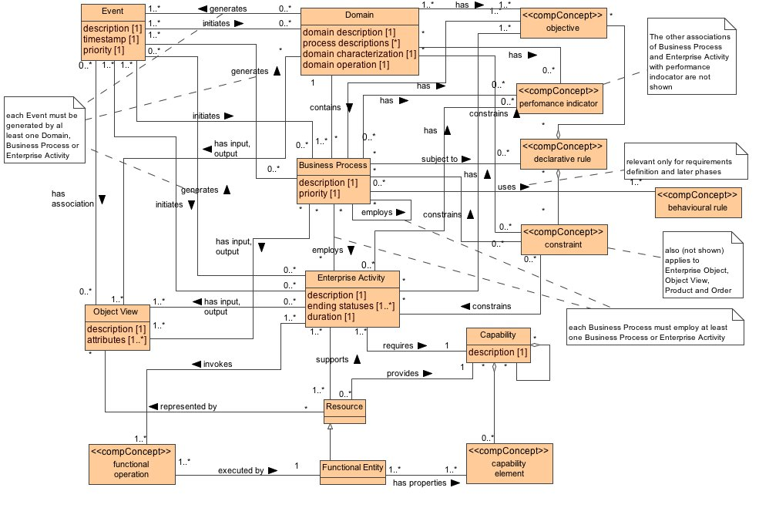
19440 Figure B.4 Functional aspects

Slide 18
ISO 14258- Published 1998
Focus is on: Concepts & Rules
Based on “System Theory”
Introduces 2D perspective
  Plan/Build, Use and Operate, Dispose
  What, How and Do Activities
Addresses:
  Hierarchy, Structure, Behavior, Real World, Reqts for model interoperability
14258 will be incorporated into upgraded 15704 version

Slide 19
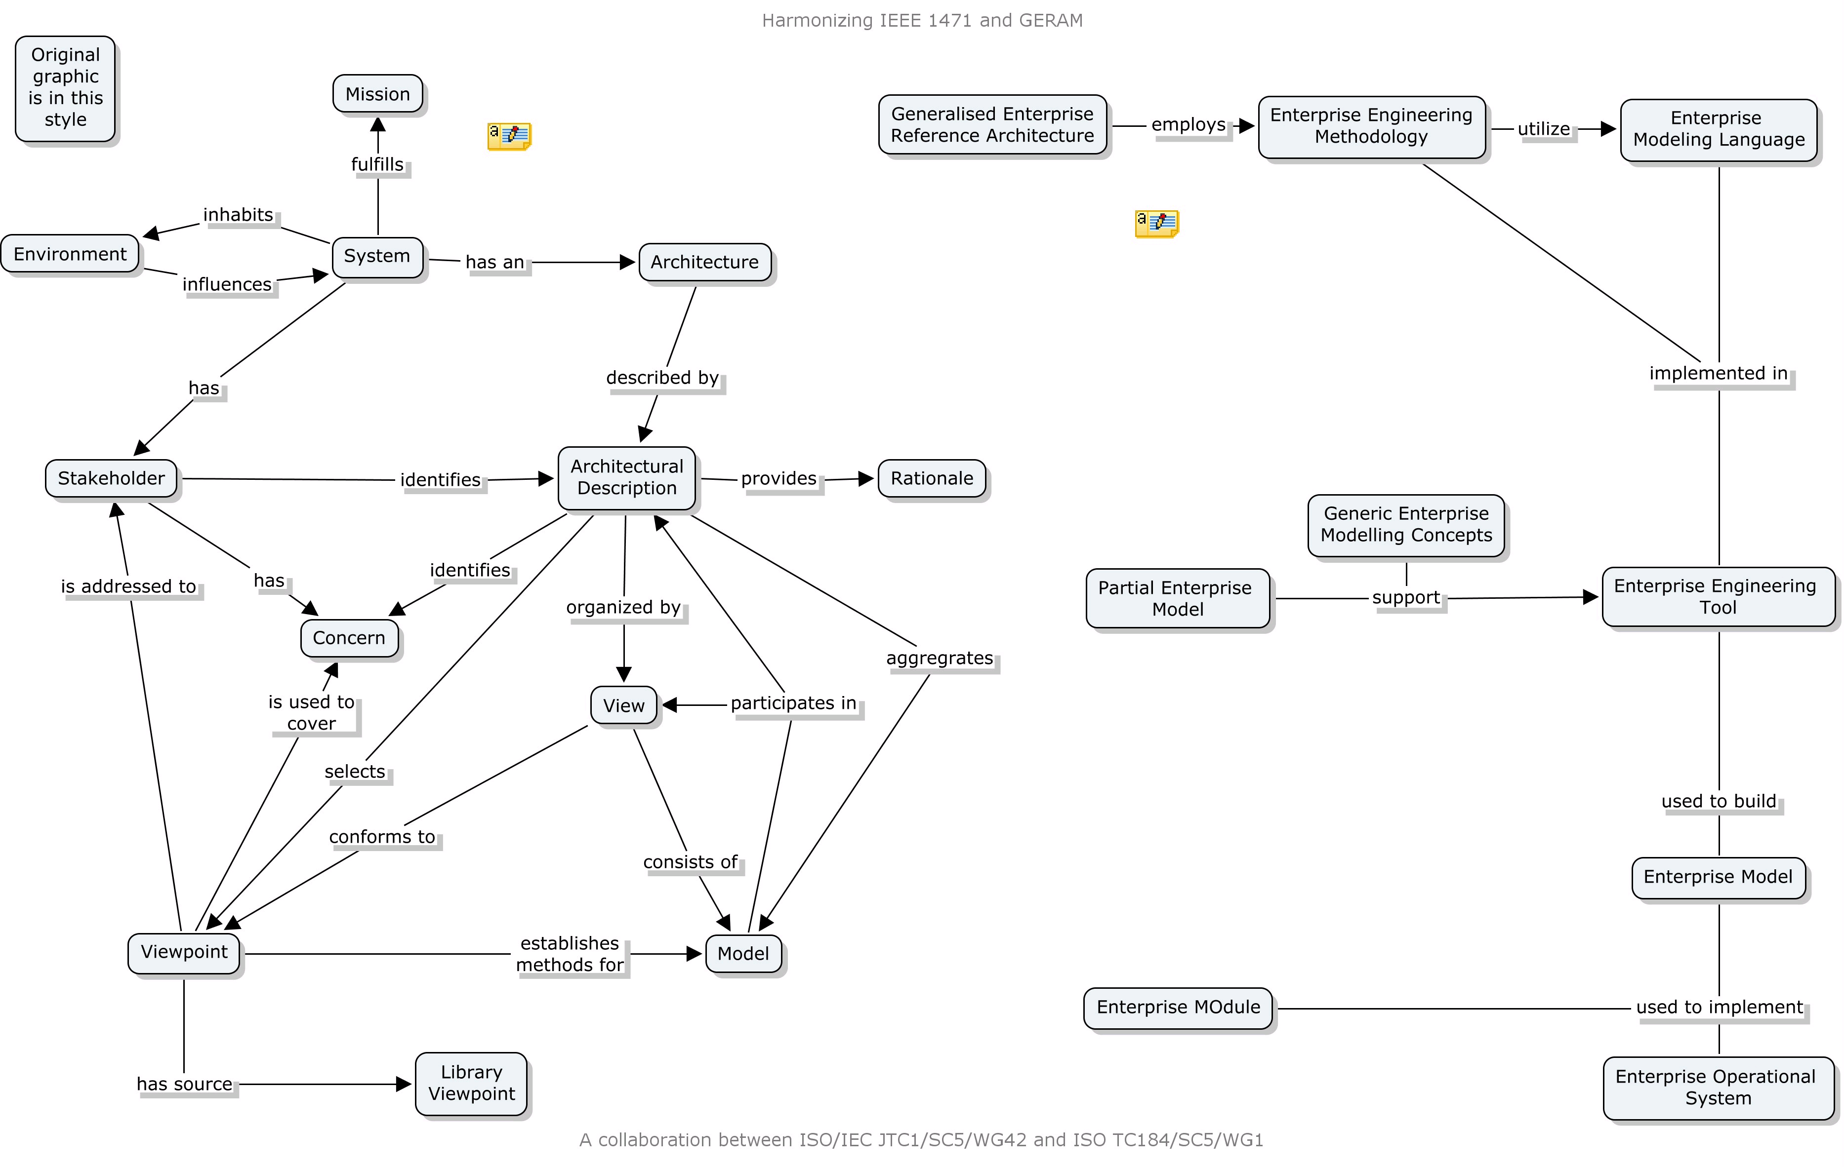
ISO 15704 and IEEE 1471 Meta Models
TBD

Slide 20
Overall Multitude Int’l Architect Standards, etc
ISO
The Others
15704
25961
(IEEE 1471, etc.)
Europe:
MODAF,
ETC
US/DoD:
FEAF,
DODAF,
CADM,
ETC
14258
(2D)
15288
(SE)
12207
(SW)
19439
(3D)
19440
Model
Language
OMG:
SysML,
UML,
ETC
IEEE,
TOGAF,
ETC
ETC
ISO Liaisons ?
ISO Liaisons
10303:
AP233, etc.
Vocabulary
&
Definitions
Others: Japan,
China, etc. ?
INCOSE Liaisons ?
ISO TC184/SC5
ETC
ISO JTC1/SC7
Bottom Line: People are in Multiple Int’l Efforts

Slide 21
2- JTC1/SC7/WG42
WG42 established June 06- identifying members
ISO/IEC 25961: Fast Tracking IEEE 1471-2000
Includes systematic review of TC184/SC5/WG1’s 15704:2000 (Liaison Activity)
Harmonize with ISO 15288 & 12207 (ISO Systems and Software Engineering Standards)
  FYI; 15288 now in revision also
Includes Vocabulary Reconciliation
  Includes architecture “views” and “viewpoints” among other SE terms and ISO/IEC 10746
Includes 1 yr Milestone:
  Possible Reassignment & Re-staffing
INCOSE STC also supporting this effort

Slide 22
3- ISO/JWG8: Data Standards
(ISO 10303, Includes 100+ standards
Industrial Manufacturing Management Data
Extensive set of standards, over 100
  AP233 one of the more well known standards under this umbrella
INCOSE also involved in this effort

Slide 23
4- ISO SC5/SG1
Identifying vocabulary overlaps/conflicts and recommending commonality in SC5 Standards
  Currently reviewing over 500 terms/words and definitions, many overlaps and inconsistencies
  Similar effort to SC7
  Similar challenges with use of terms/words and definitions
These efforts need to be further coordinated across themselves (an ISO Liaison task).
Then what about the other international architecture and SE activities?

Slide 24
Current ISO SC5/WG1 & INCOSE Activities
ISO TC184/SC5/WG1
  Developing Plan for 15704 revision
  Evaluating 15704/GERAM & IEEE1471
  Involved with INCOSE, OMG (SysML & UML), etc.
  Considering DODAF 2.0 Efforts/Evolution
  Reviewing 15704/GERAM Comments & Recommendations from Manufacturing Industry
  Terminology Issues
INCOSE
  Standards Tech Committee: Committed to Supporting SC5/WG1, SC7/WG7, etc.
    Among Higher STC Priorities
  INCOSE TC184/SC5 Liaison (Mark Walker Lead)
  INCOSE Connect Webpage Established
  INCOSE INSIGHT Articles (Jan & April 07)
  ISO EA Standards Tutorial- Symposium ‘07

Slide 25
Overall Assessment
Many Semi-Independent International Architecture Standards & Activities
  Harmonization is Critical, Too Many Conflicting Terms, Many Perspectives, Varied Applications
Other Issues:
  US/DoD Architecture Perspectives (DODAF, CADM, FEAF) – DODAF 2.0 Coming in ‘07
  INCOSE Architecture related WGs biased towards DoD/US Gov’t perspectives/needs
ISO TC184/SC5 EA Standards biased to Int’l & Manufacturing Industry Architecture Perspectives
Harmonizing these diverse International EA viewpoints together is a major challenge
Being involved provides Opportunity to Learn future direction of Architecture & Influence Resulting Standards, Applications, etc.

Slide 26
Challenge to Chesapeake Chapter
Should we start an Interest Group?
  Understand the ISO EA Standards,
  Application to our companies and customers
  Involvement with INCOSE Liaison Efforts
  Learn Potential Architecture Principles, Methods, Terminology, Perspectives, Applications, etc.
Who is Interested?

Slide 27
Backups

Slide 28
15704 Contents: Requirements
Applicability and coverage of enterprise-entity types
  Generality
  Enterprise design
  Enterprise operation
Concepts
  Human oriented
  Process oriented
  Technology oriented
  Mission-fulfillment oriented
  Mission-control oriented
  Framework for enterprise modeling
  Life cycle, Life history
  Modelling views
  Genericity

Slide 29
15704 Contents: Requirements & Annexes
Components of enterprise-reference architectures
  Engineering methodologies
  Modelling languages
  Generic Elements
  Partial models
  Particular models
  Tools
  Modules
  Enterprise-operational systems
Annexes:
  Representation
  Glossary
  Completeness and compliance

Slide 30
15704- Benefits
The enterprise-reference architecture and methodology requirements
  checklist for completeness with respect to current and future purpose.
Relevant to any group charged with improving an enterprise infrastructure or its processes.
  Select or create a reference architecture of its own
  Terminology that pertains specifically to the company, industry, and culture involved.

Slide 31
15704 – Aim & Benefits for enterprise-reference architectures & methodologies
An enterprise-reference architecture with associated methodologies & enterprise-engineering
Technologies that fulfill requirements enable integration & planning
Teaming to determine and develop course of action that is complete, accurate, properly oriented to future
Business developments to:
  describe tasks required;
  define necessary quantity of information;
  specify relationships among humans, processes, and equipment in integration considered;
  address management concerns;
  address relevant economic, cultural, and technological;
  computer-support required;
  support process modelling for enterprise history

Slide 32
INCOSE Activities
INCOSE Standards Tech Committee
  Standards TC working with other WGs
  Developing Overall INCOSE Approach and Plan
  Coordinate INCOSE WG involvement, tasks, etc.
  Liaison for ISO Standards efforts
  Developing Standards Architecture Tutorial(s) for ’07 Symposium and Jan ‘07 Int’l Workshop
Other INCOSE WGs
  Mark Sampson- Consolidating Arch Info.
  Identify ISO WG(s)/standard(s) of interest
  Identify WG Lead and others who will support
  Contact STC with WG’s intentions, focus and objectives for involvement
Special EA Workshop @ Jan ‘07 IW

Slide 33
INCOSE Involvement
Level of INCOSE Involvement
  At INCOSE Symposium, July 06
    Strong Additional WG, etc. interest established
    Mark Sampson to capture scope of architecture activities
    Established ISO TC 184/SC5 website, etc.
    Initiated INCOSE awareness and recommended INCOSE Steering Committee
  INCOSE Liaison for ISO SC7/WG42 (IEEE 1471) Fast Track effort
Involvement of other INCOSE WGs: Strong interest
  Architecture, Model Driven System Design
  Tools Database, Tools Integration and Interoperability
  Information Systems
  Requirements & OOSEM & SysML

